Slide 1
Digital Portfolio
STUDENT NAME: Padma logini.M
REGISTER NO AND NMID:
DEPARTMENT: II BSC.CS
COLLEGE:KPR COLLAGE OF ARTS SCIENCE AND RESEARCH/ BHARATHIYAR UNIVERSITY

Slide 2
HOME BACKING

Slide 3


AGENDA
API Integration
Agent Role Definition
Tool Creation
Memory Management
Prompt Engineering
Reasoning and Planning
Multi-Agent Collaboration
Interface and Deployment
Monitoring and Feedback Loop
Framework Selection
Want to go deeper into any one of these?
3/21/2024 Annual Review

Slide 4

PROBLEM STATEMENT
Problem statement for backing up data (like database/website backups)?
Problem statement for backing in finance (like loan backing, security backing)?
Problem statement for backing in algorithms (like backtracking in programming)?

Slide 5

PROJECT OVERVIEW
This project focuses on the process of baking cakes as both a culinary skill and creative art.
It involves preparing different cake recipes, experimenting with flavors, textures, and decorations.
The goal is to produce soft, delicious, and visually appealing cakes suitable for various occasions.
The project also highlights the importance of measurement accuracy, baking techniques, and presentation.

Slide 6

WHO ARE THE END USERS?
The end users of this project are individuals or customers who enjoy fresh, delicious cakes for personal consumption or special occasions.
They may include families, students, event organizers, and bakery customers.
The project ensures cakes are baked to meet their needs for taste, quality, and presentation.

Slide 7

TOOLS AND TECHNIQUES
Tools:
Mixing bowls, measuring cups, and spoons
Electric mixer/whisk and spatula
Baking tins/molds and parchment paper
Oven or microwave for baking
Cooling rack and decorating tools (icing bag, nozzles, etc.)
Techniques:
Measuring and mixing ingredients accurately
Creaming, folding, and whisking methods
Temperature and time control during baking

Slide 8
POTFOLIO DESIGN AND LAYOUT
Cover Page – Project title, your name, and an image of a cake.
2. Introduction – Brief about baking and project purpose.
3. Tools & Techniques – Short description with 2–3 pictures.
4. Process & Results – Step-by-step baking with final cake images.
5. Conclusion – Learnings and benefits for end users.
8

Slide 9
FEATURES AND FUNCTIONALITY
Bones (Biology/Medical) → e.g., bone fracture and its function in the body.
Materials/Engineering → fracture of materials and their functional strength.
Or related to your baking project (maybe a typo for “structure and function” of cakes)?

Slide 10
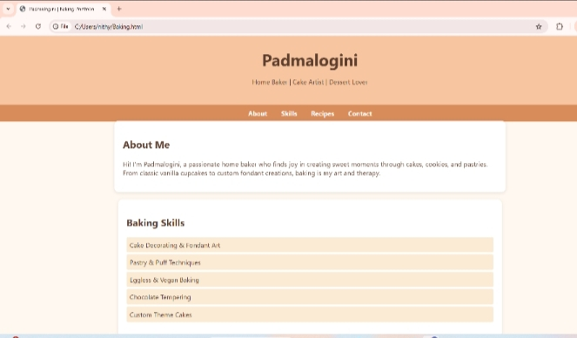

RESULTS AND SCREENSHOTS
Result:
The project resulted in well-baked, soft, and tasty cakes.
Proper tools and techniques improved texture and decoration.
End users enjoyed the cakes, proving the project’s success.
3/21/2024 Annual Review
10

Slide 11
CONCLUSION
The baking project enhanced skills in measurement, mixing, and decoration.
It proved that with proper tools and techniques, high-quality cakes can be prepared to satisfy end users.
11

